Slide 1
01 | Introduction to Bootstrap
Christopher Harrison
@geektrainer
Content Developer
Microsoft

Slide 2
Setting Expectations
Not going to cover everything in Bootstrap
Help get you up and running on building great looking sites
Some CSS and HTML experience required
Plenty of resources available
Lots of demos
Proof of concept
Labs supplement course
Apply skills in a "real world" scenario

Slide 3
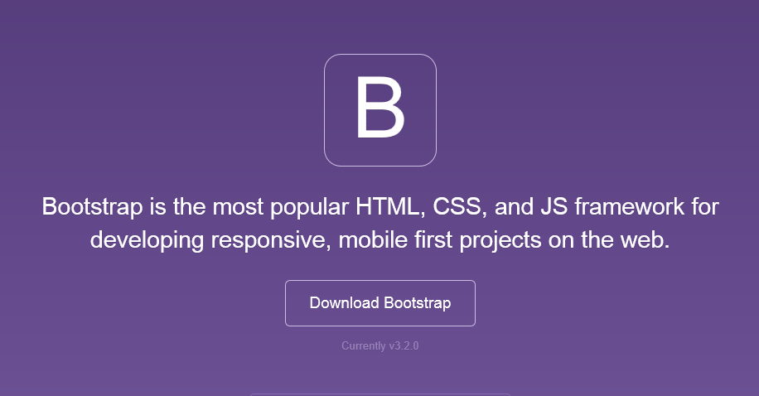
Bootstrap
The most popular front-end framework for developing responsive, mobile first projects on the web.

Slide 4
Why use it?
CSS is can be tricky
Cross browser support can be a challenge
Solves basic tasks (e.g. page layout without tables)
Bootstrap 3 makes it easier

Slide 5
Bootstrap Features
Theme Support
Responsive
Grid
Components
Pagination
Buttons
Modal
Great Visual Studio support

Slide 6





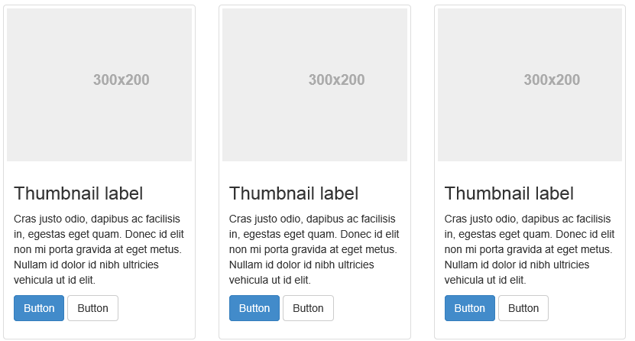
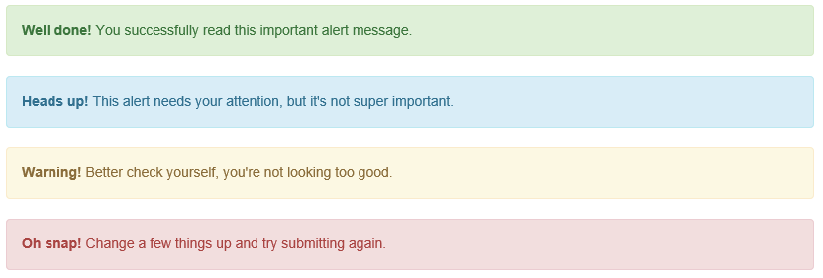
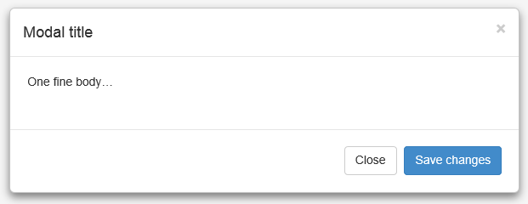
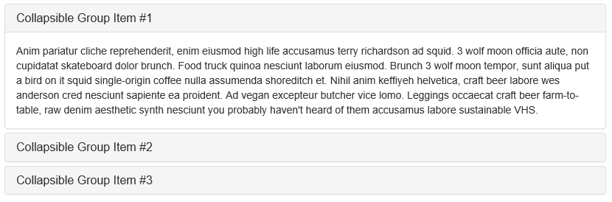
Components

Slide 7
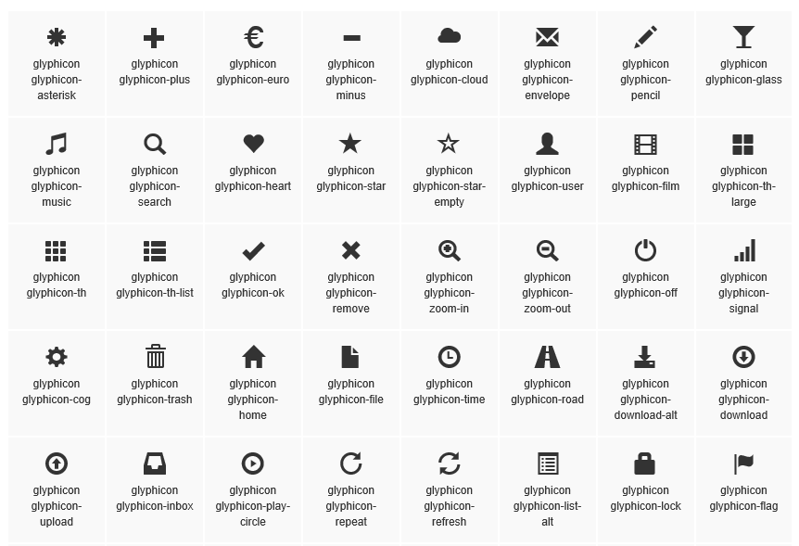
Glyphicons

Slide 8
A quick lap around Bootstrap

Slide 9
Theme Support

Slide 10
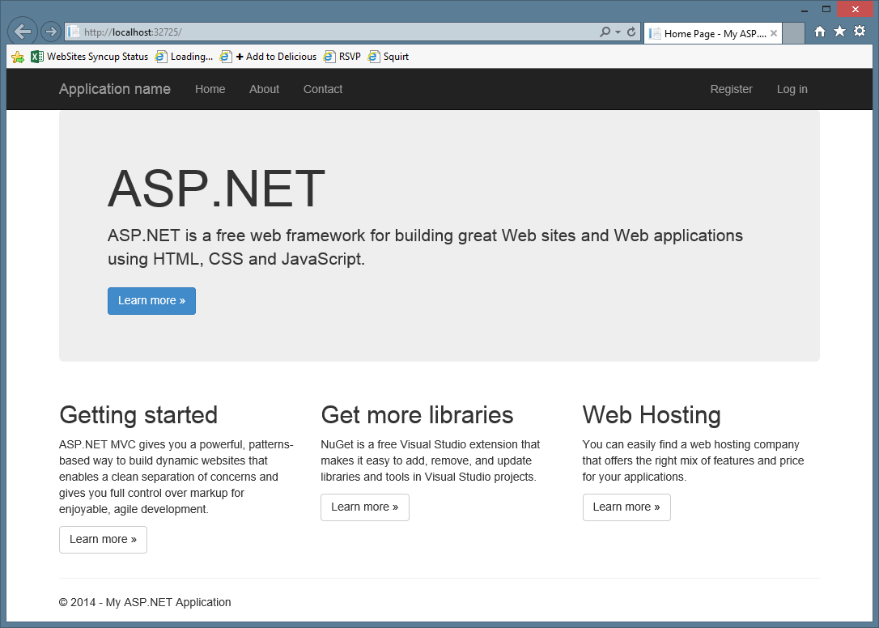

Slide 11
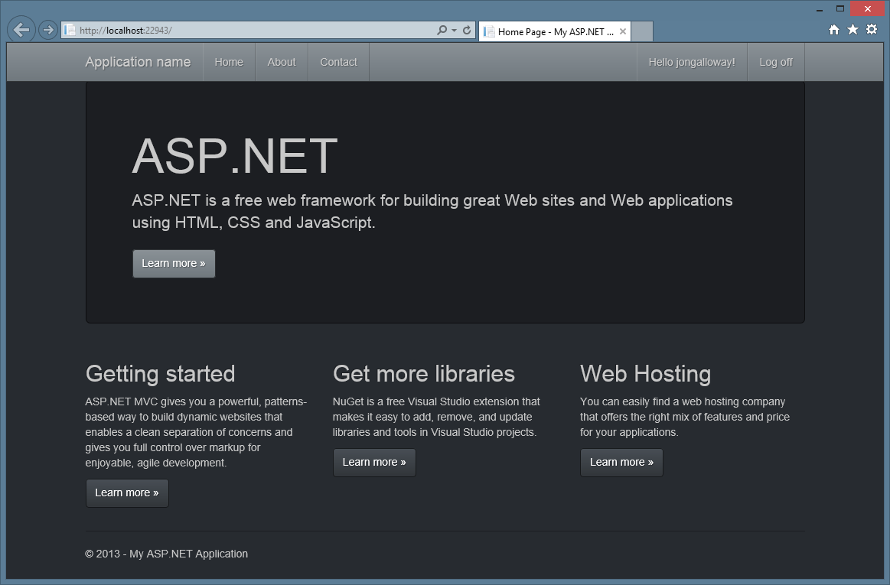

Slide 12
Bootstrap themes

